Slide 1
An evolutionary theory for the spatial dynamics of urban systems worldwide Juste Raimbault, Eric Denis et Denise Pumain UMR Géographie-cités, Paris, France ECTQG 2019, Mondorf, Luxembourg, September 5-9

Slide 2
How to explain urban growth?
Apparent direct causes : intentions/actions from urban actors (policies, locational strategies from firms, residential migrations…)
But statistical observation (thousands of cities, over centuries) : each city has a probability of growing similar to other cities belonging to the same territorial system
= « distributed growth » on the long run with many local and temporal fluctuations

Slide 3
Gibrat’s model
(« proportional » growth = growth rates are equiprobable ∀ city size and not correlated with previous rate)
Good fit ➔ double explanatory gain:
Persistancy of urban spatial patterns and hierarchies
The statistical shape of urban sizes distribution (Zipf’s law or lognormal ≈ H. Simon ≠ P. Krugman) as generated from growth process
(Gibrat, 1931, Robson, 1973, Pumain, 1982)

Slide 4
Testing the evolutionary urban theory
How are stylized facts on systems of cities robust and general ?
→ empirical study with the new Global Human Settlement layer dataset
How can dynamical models of urban systems be applied in the context of the evolutionary urban theory ?
→ test of six dynamical models, based on geographical interactions between cities but different dimensions, on different systems of cities and worlwide

Slide 5
A new source of data on global urbanization
GHSL (Global Human Settlement Layer) : GEO Human Planet Initiative (European Commission)
Built up area from satellite images 40 m + population data 250 m ➔ 1 km² grid
13 000 urban areas > 50 000 inhab.
Surface, population in 1975, 1990, 2000, 2015
GDP, Green surfaces Pollutants 1990-2015

Slide 6
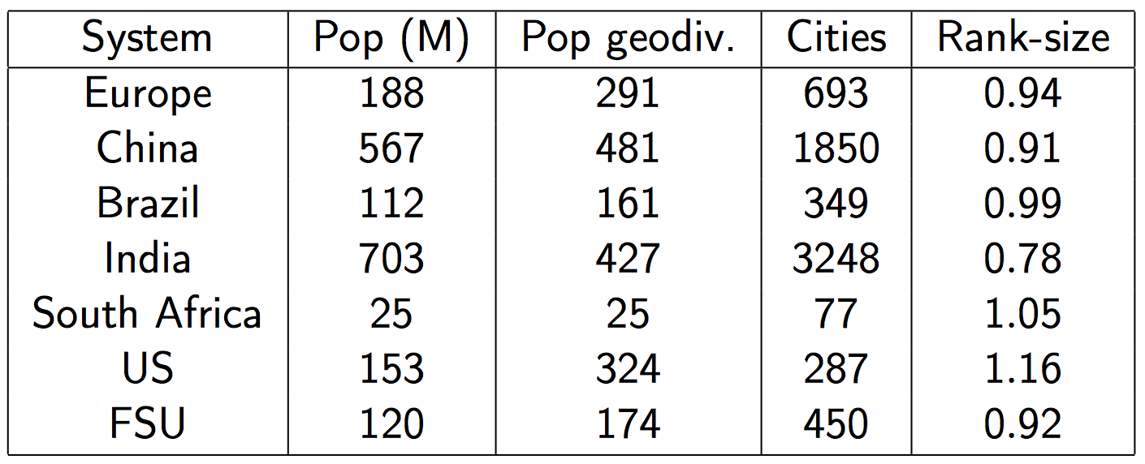
Urban systems summary
Summary statistics in 2015 for urban systems [Pumain et al., 2015]

Slide 7
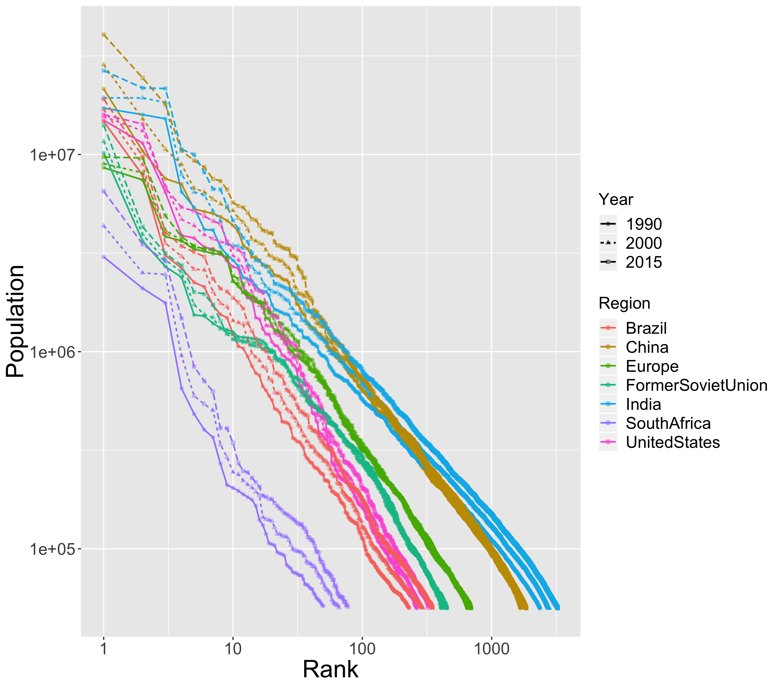
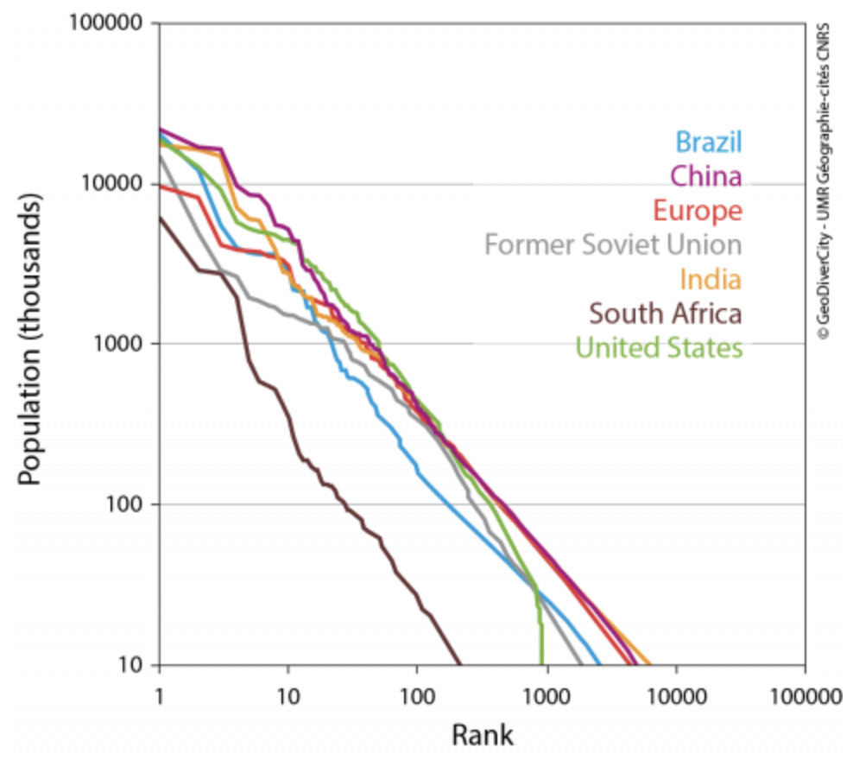
Urban systems hierarchy
Reproducing results of [Pumain et al., 2015] for large urban systems
→ Robustness of qualitative stylized facts to the database

Slide 8
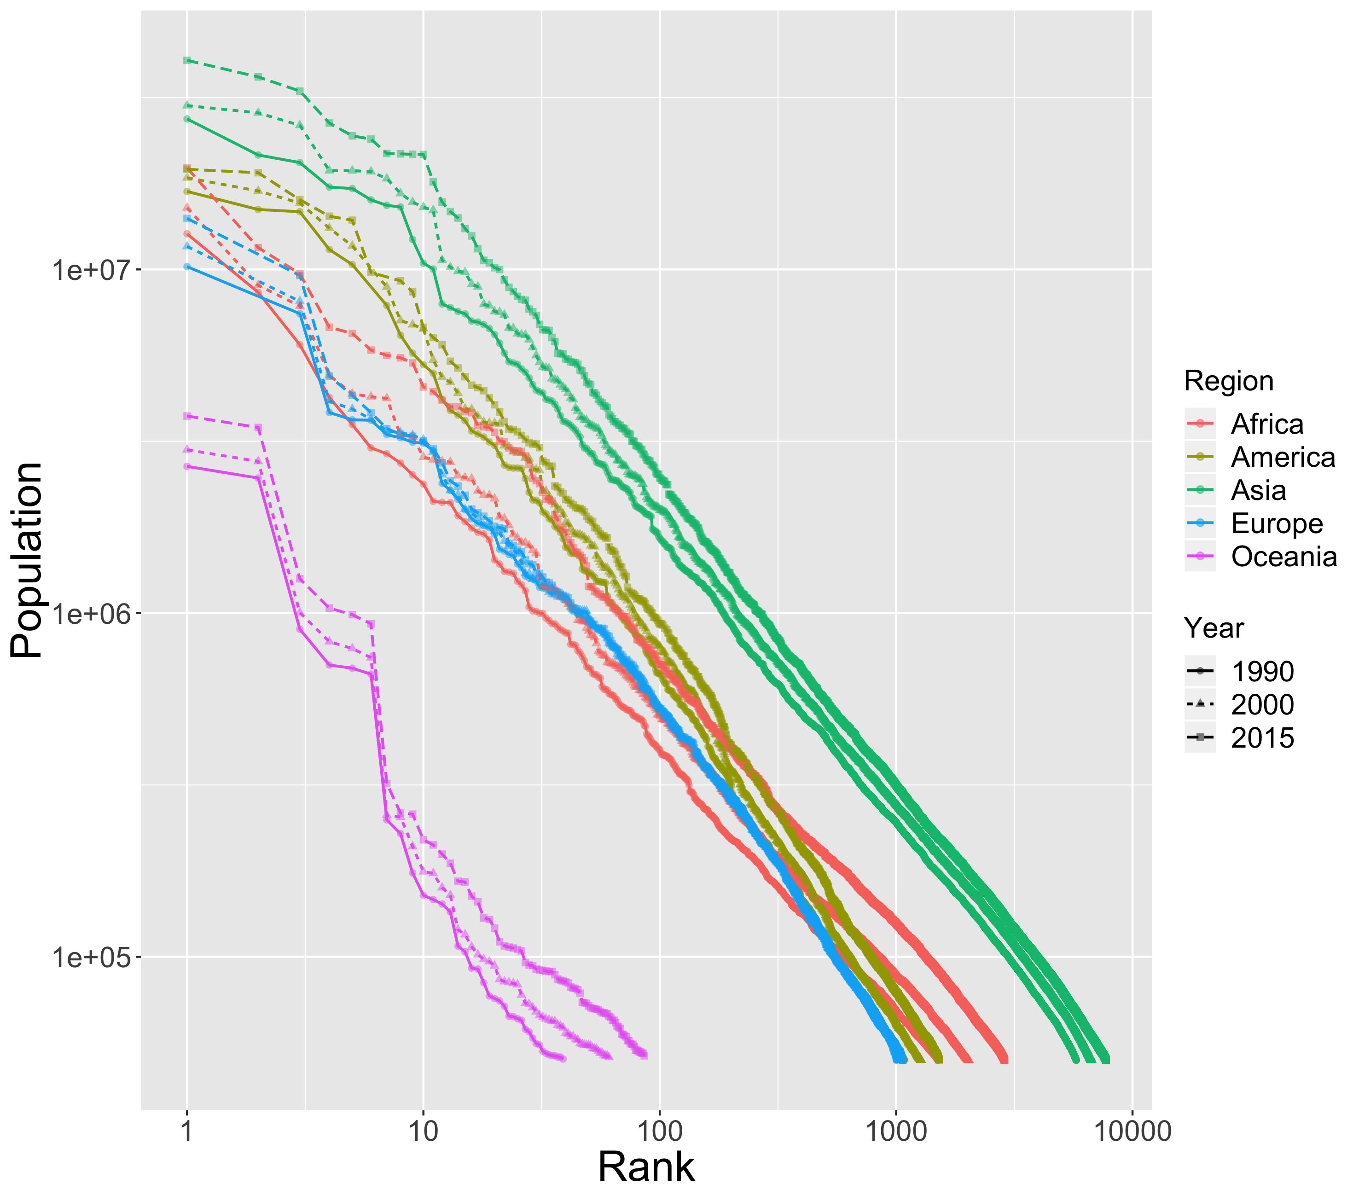
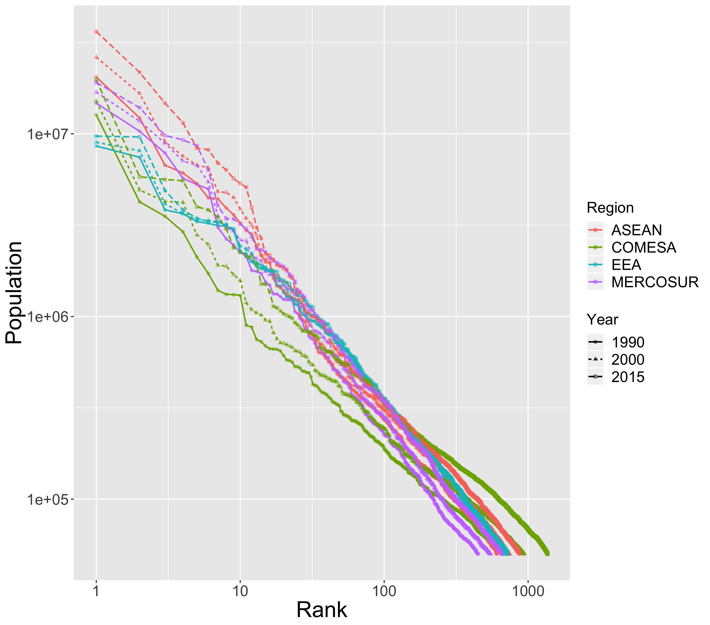
Rank-size by continents or trade areas
Reproducing results of [Pumain et al., 2015] for large urban systems
→ Possibility to extend analysis to other consistent geographical ensembles

Slide 9
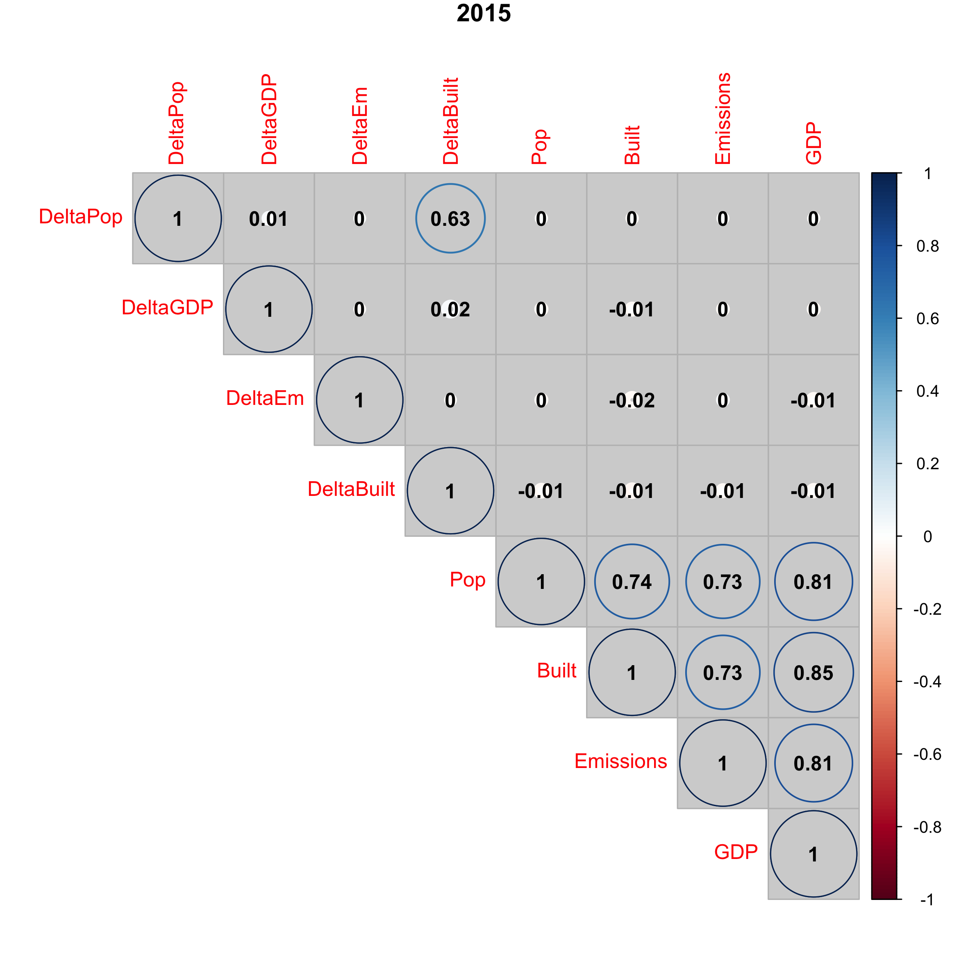
Correlations between urban indicators

Slide 10
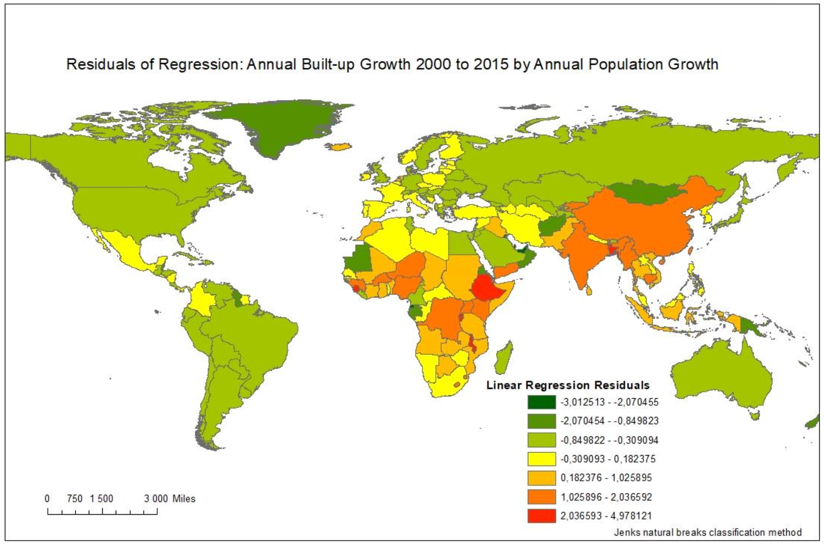
Linking urban growth and built-up area growth
Geographical structure in the relation between population growth and built-up area growth

Slide 11
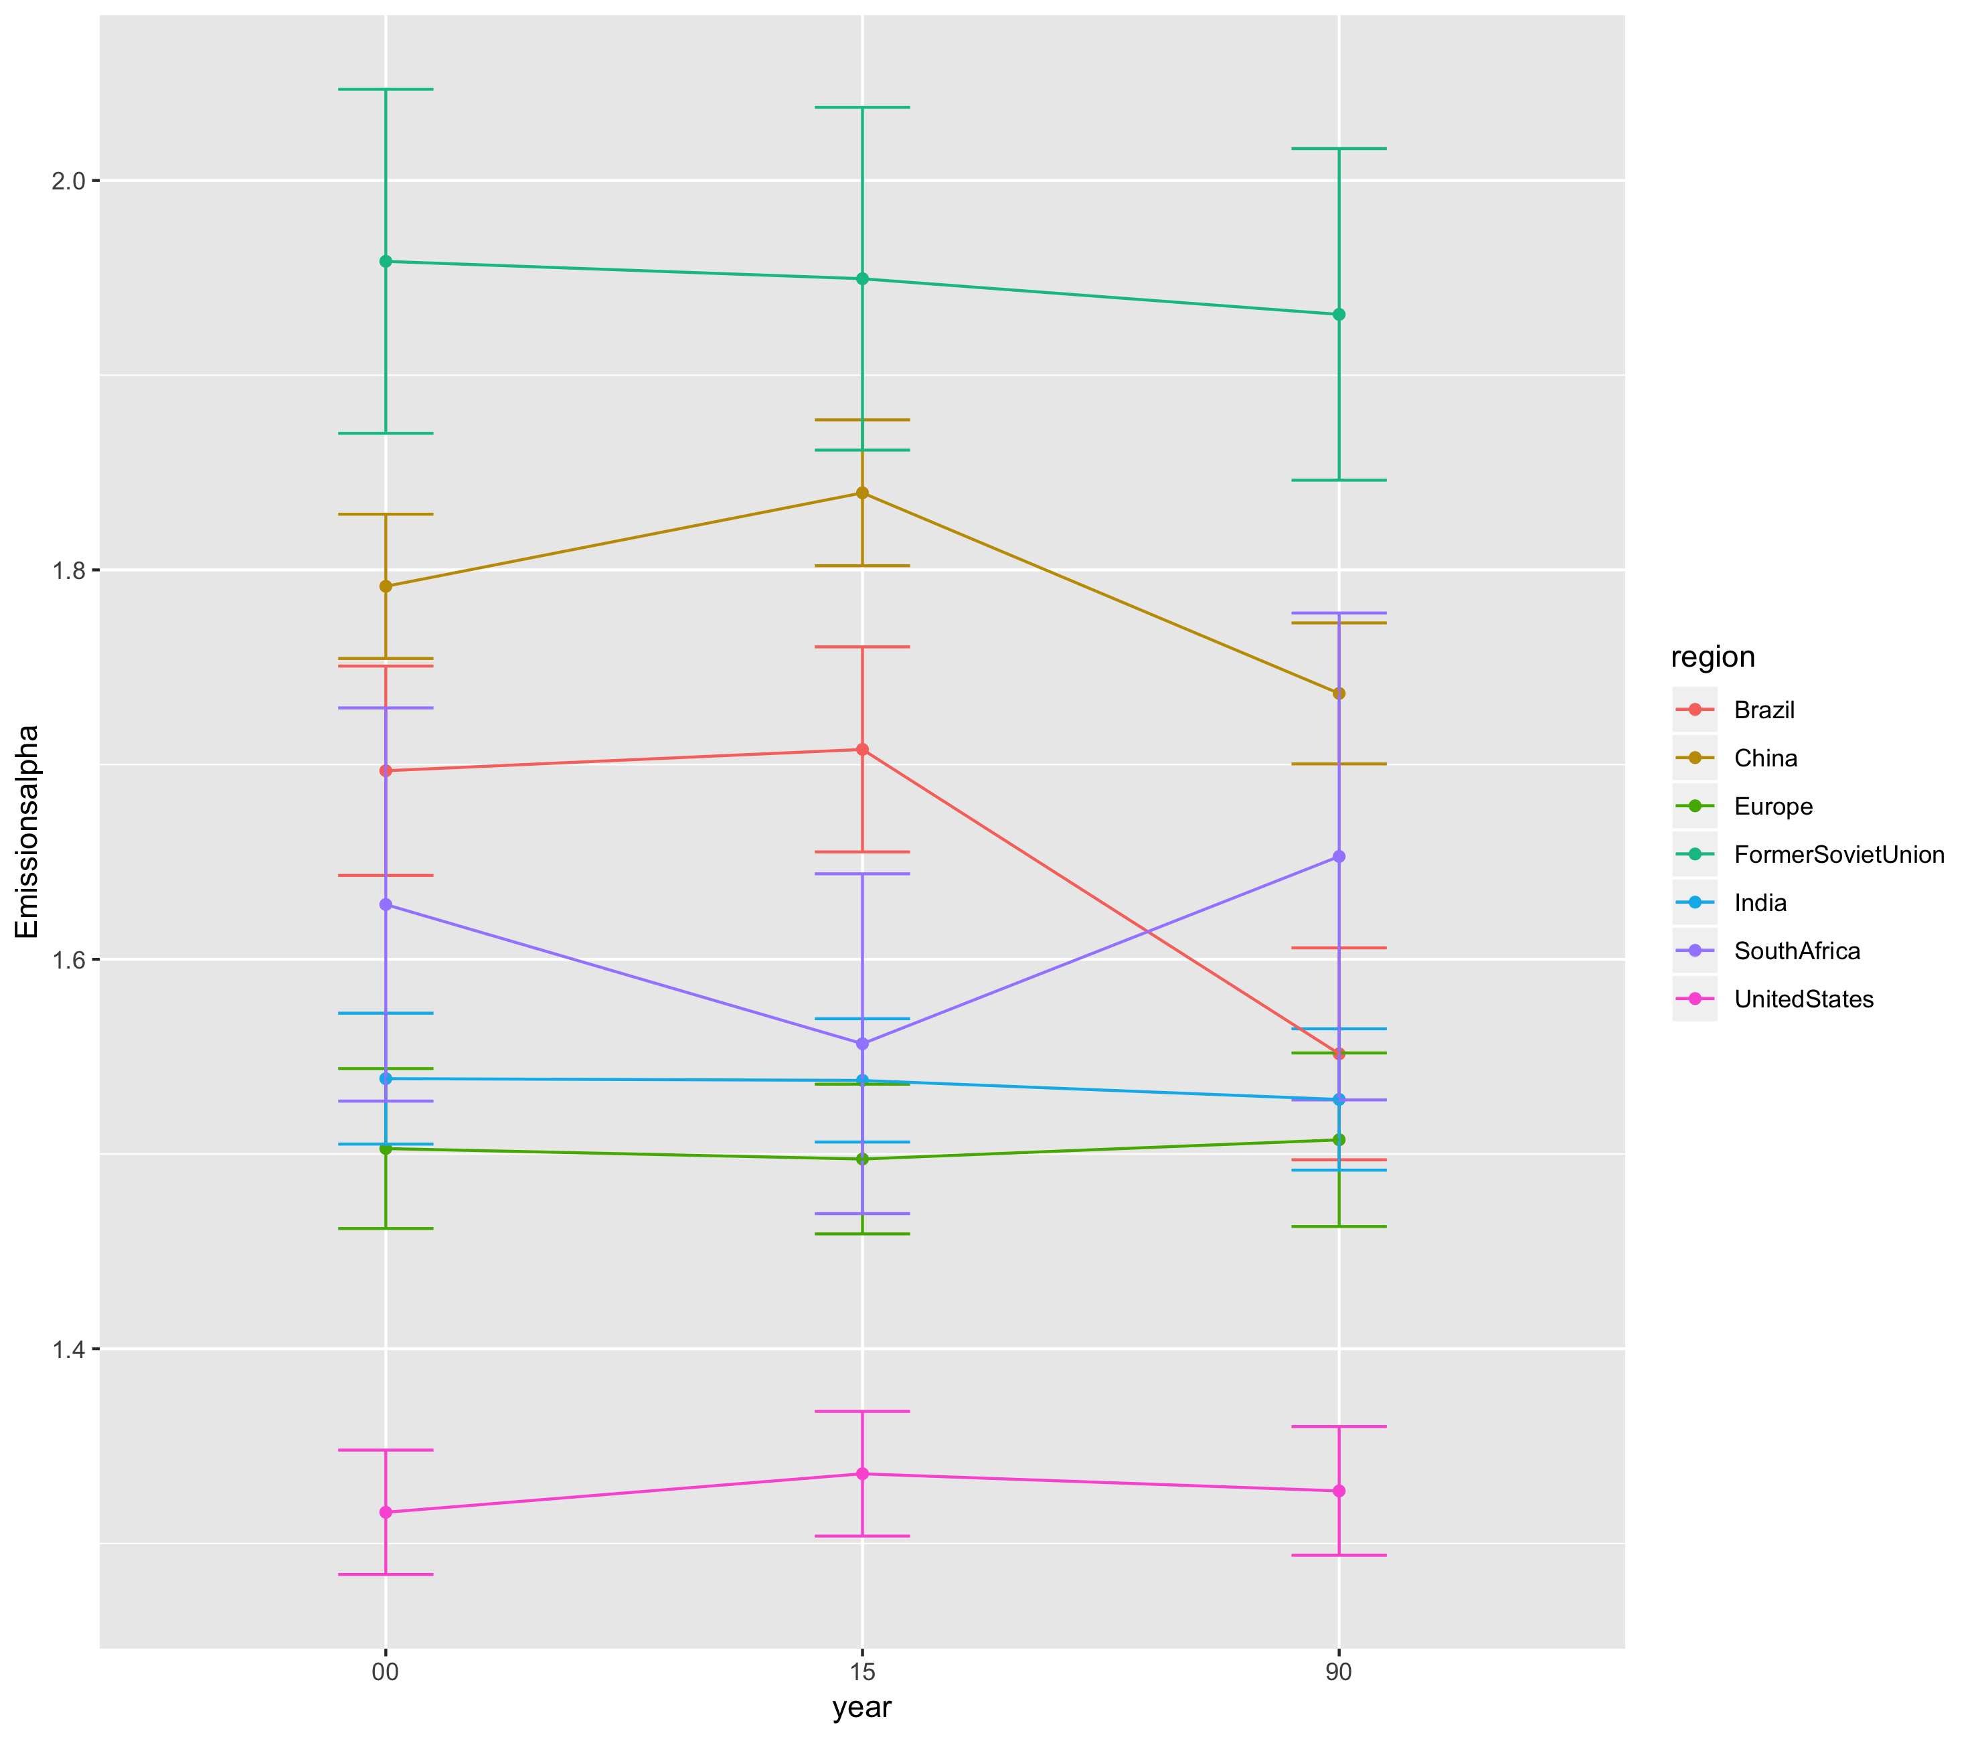
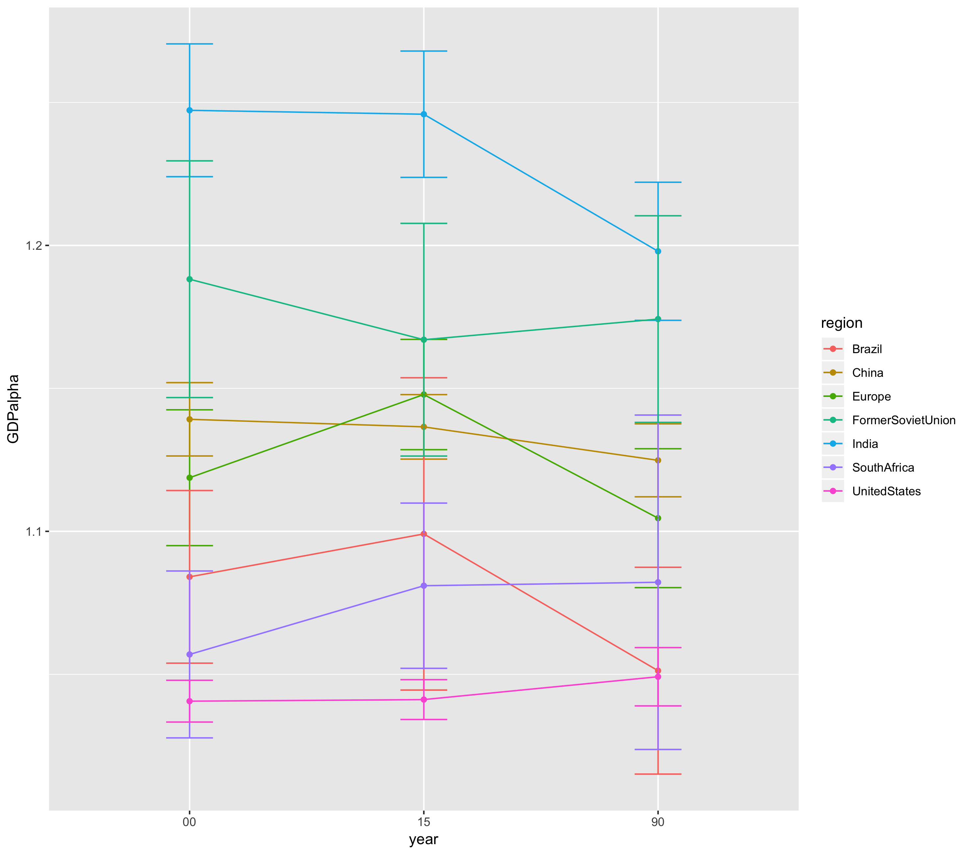
Evolution of scaling exponents
All indicators are stable in their confidence range

Slide 12
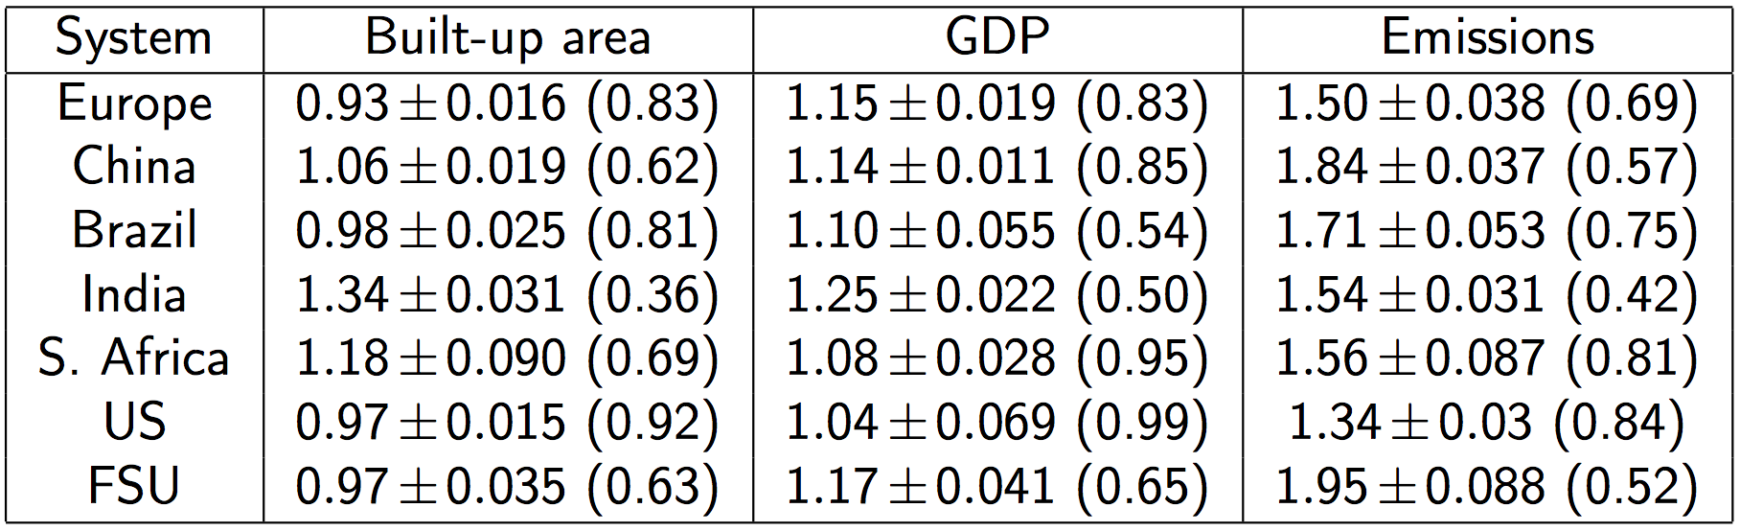
Summary of scaling exponents
→ more general, more or less consistent study of scaling (“basic” indicators but on consistent and global geographical areas)

Slide 13
Dynamical models of urban growth
Testing interaction-based dynamical models for urban growth
The Favaro-Pumain model for the diffusion of innovation [Favaro and Pumain, 2011]
The Marius model family based on economic exchanges [Cottineau, 2014]
An interaction model including physical transportation networks [Raimbault, 2018]

Slide 14
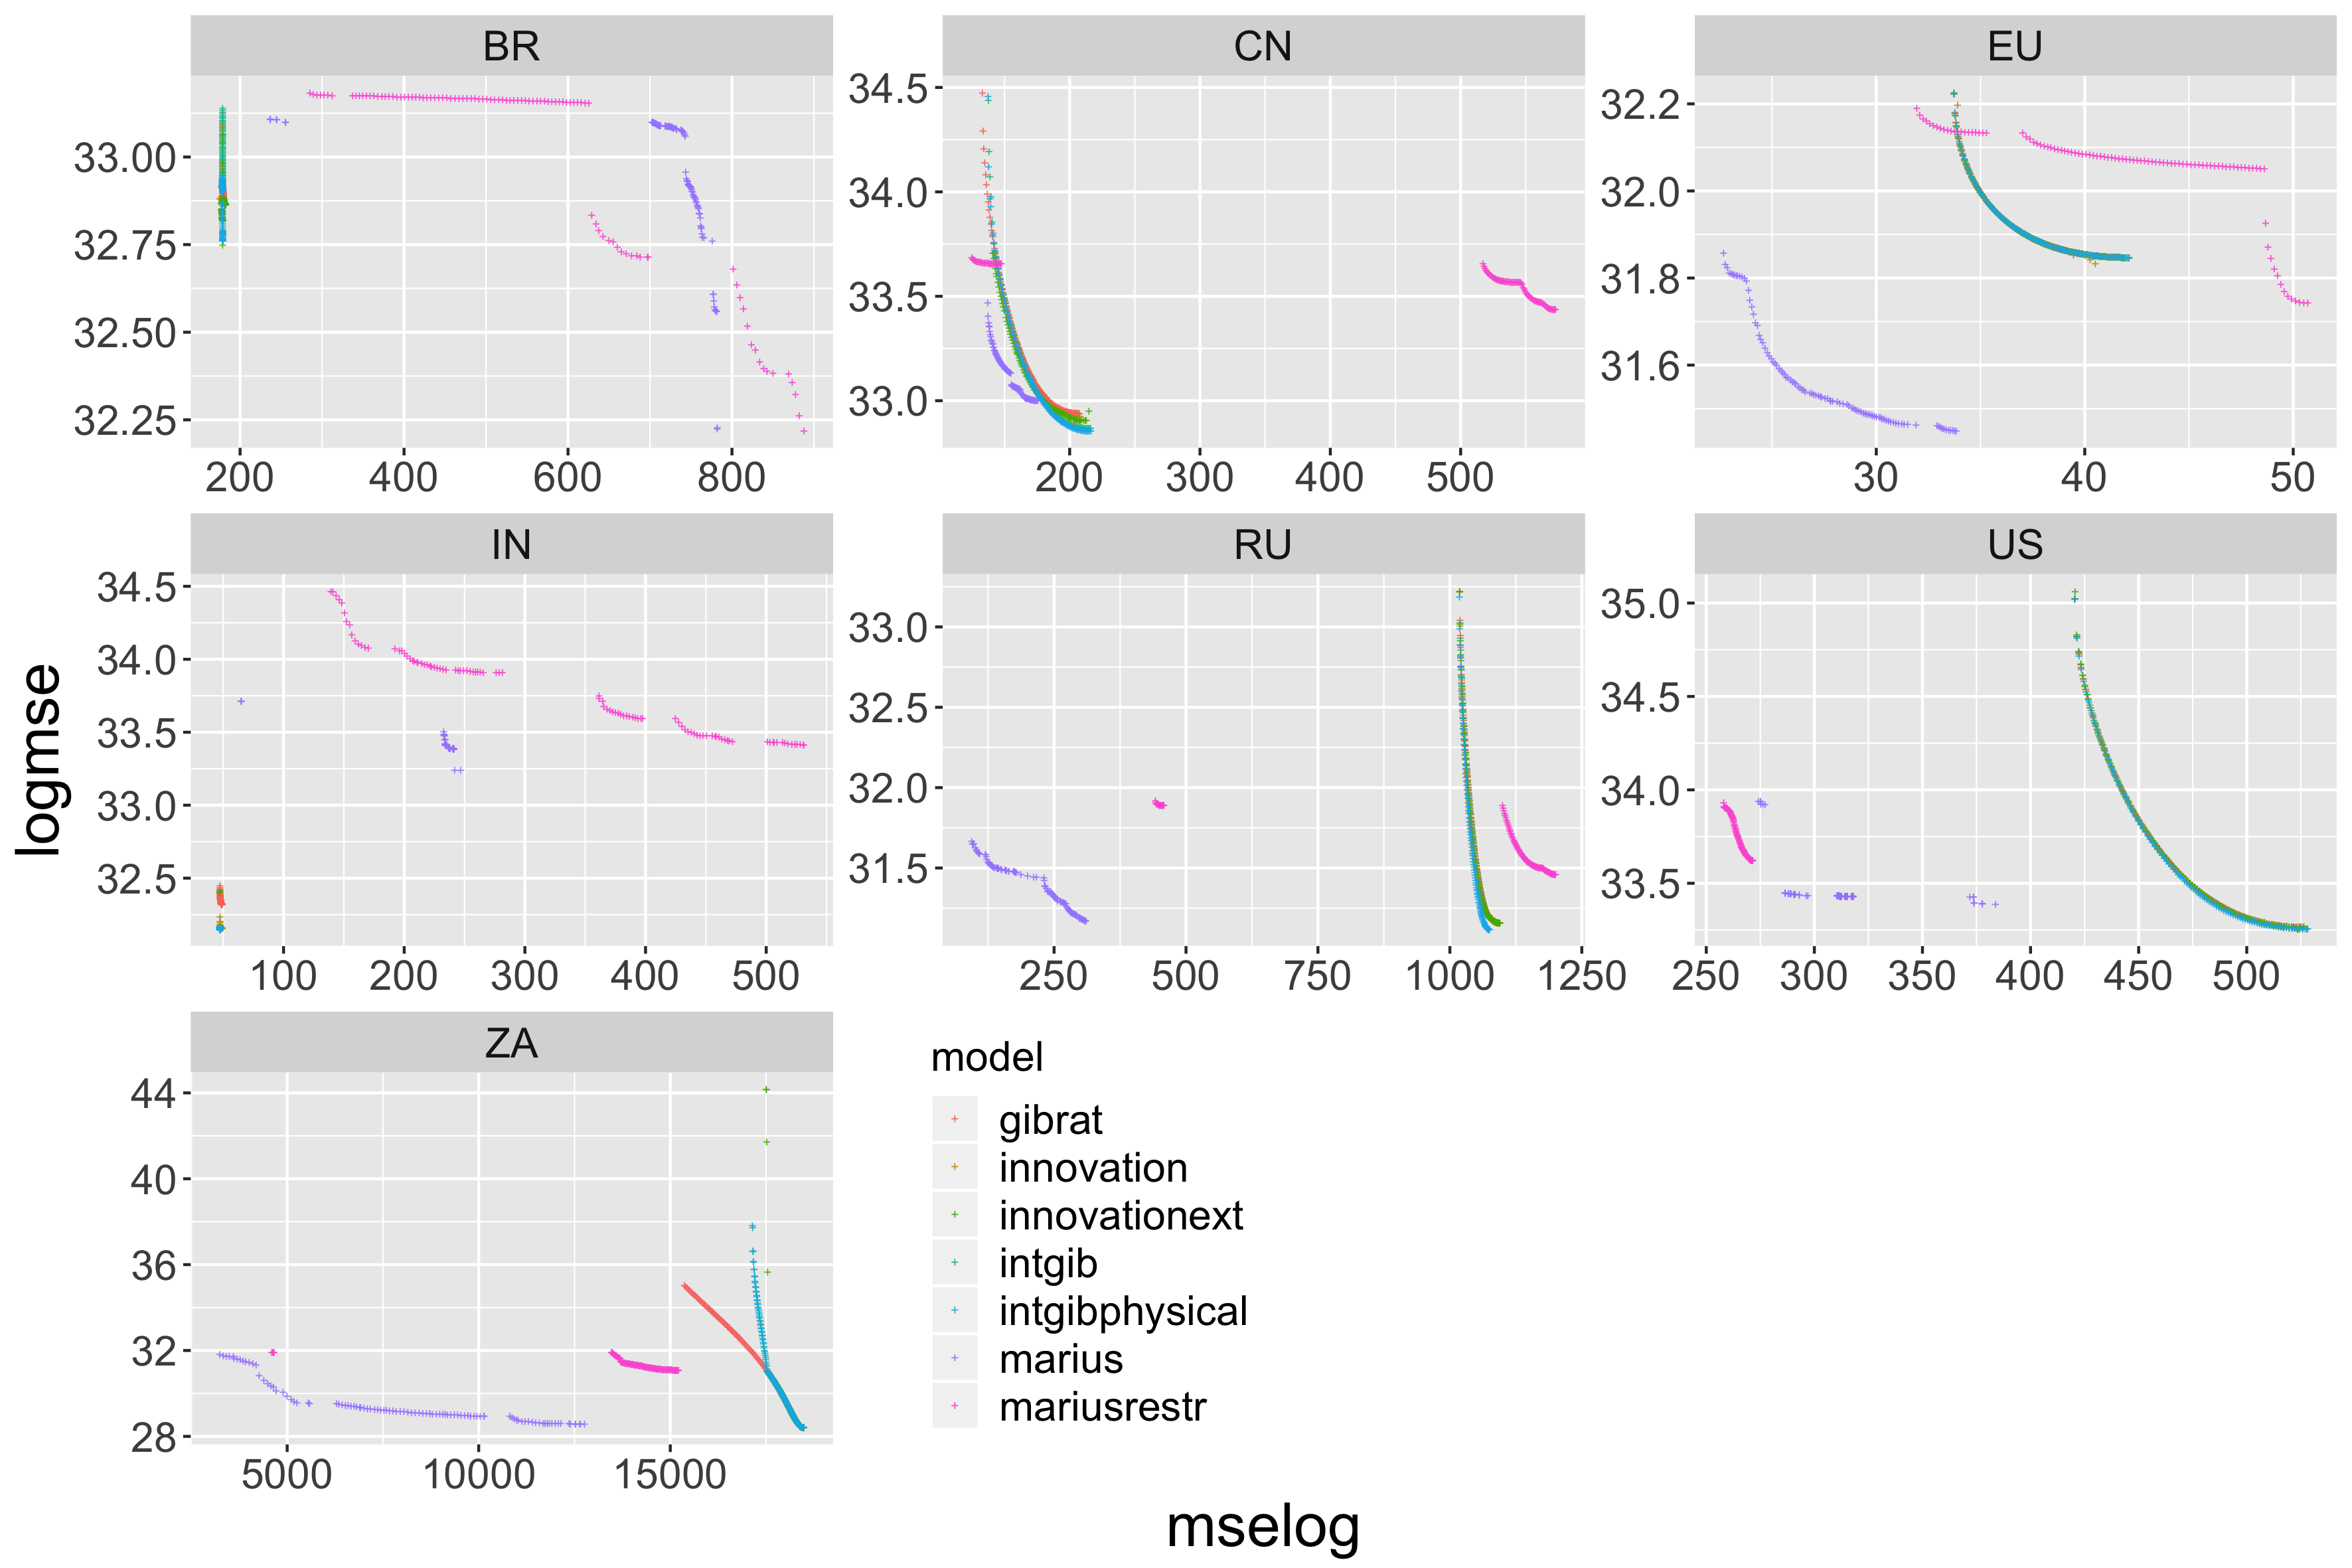
Calibration of dynamical models on regional systems

Slide 15
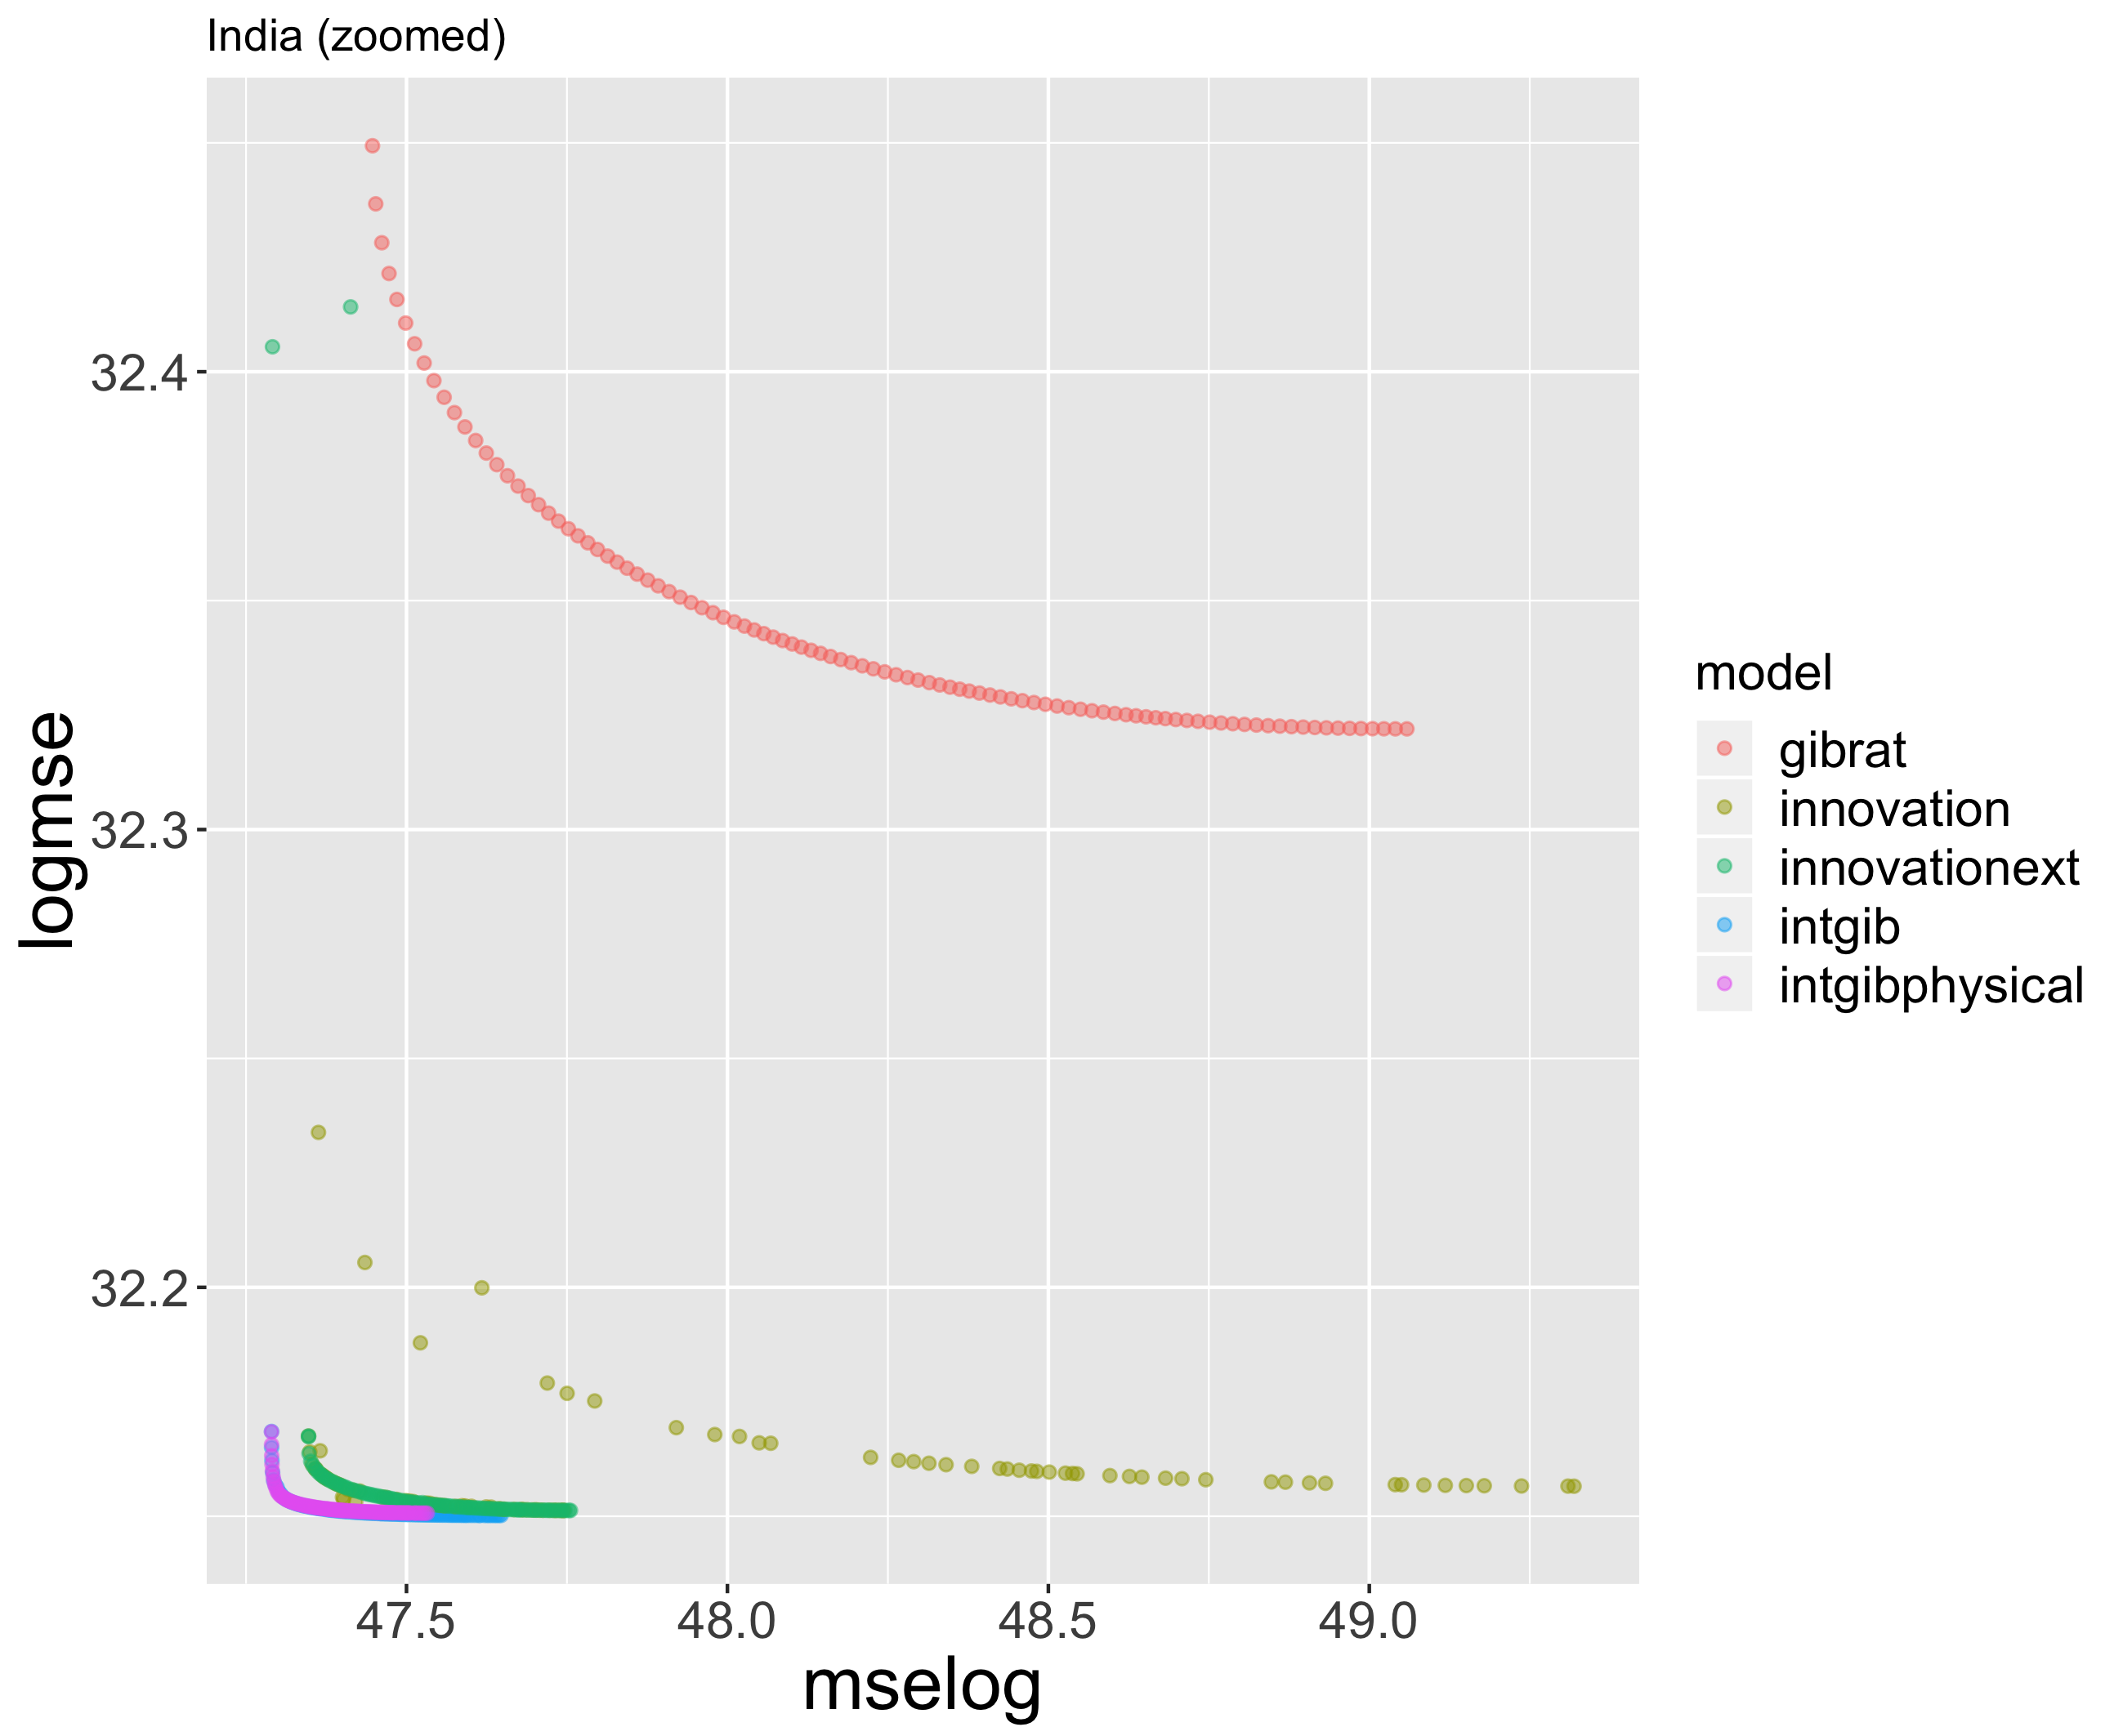
Indian urban system: direct interactions

Slide 16
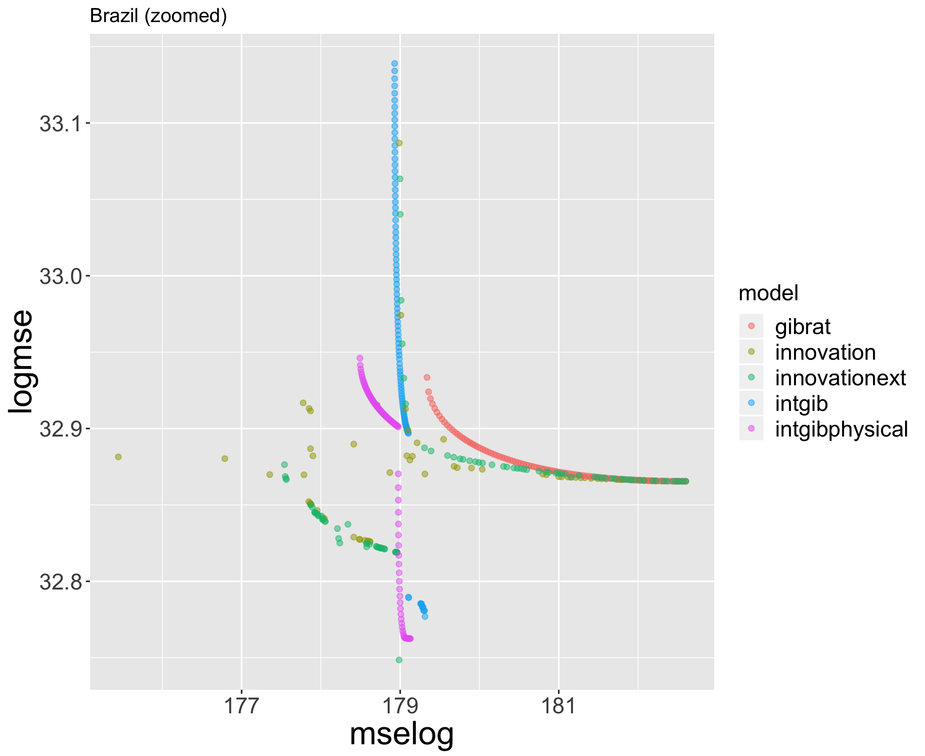
Brazilian urban systems: multiple factors
Importance of topography; innovation processes mostly.

Slide 17
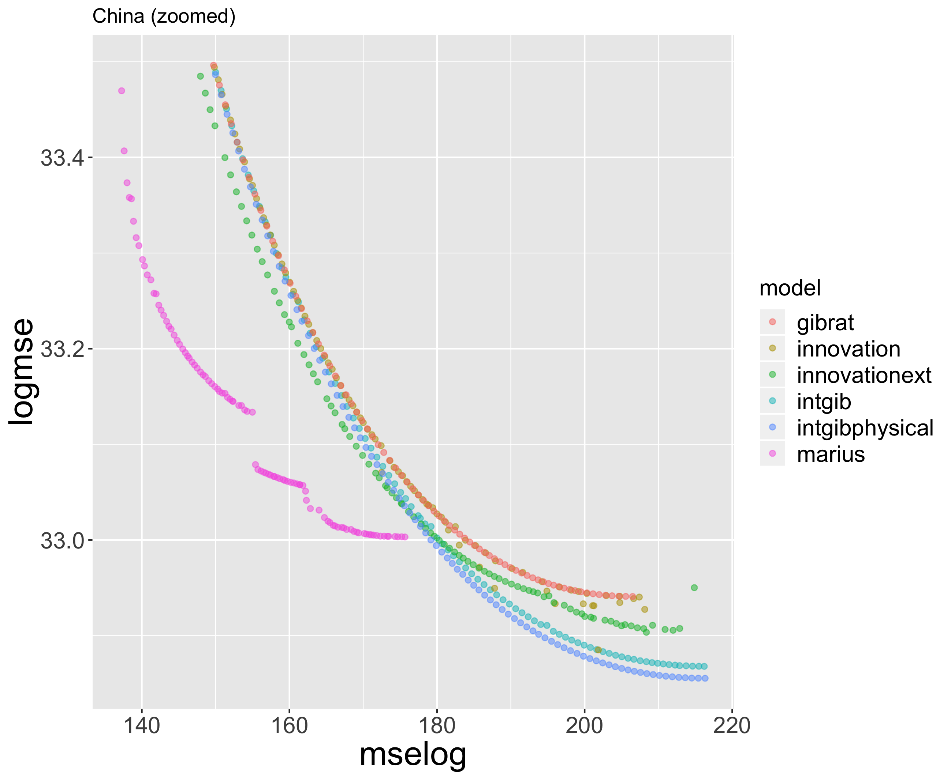
China urban system: similar models
No clear best model: other processes in play ? (strong top-down planning)

Slide 18
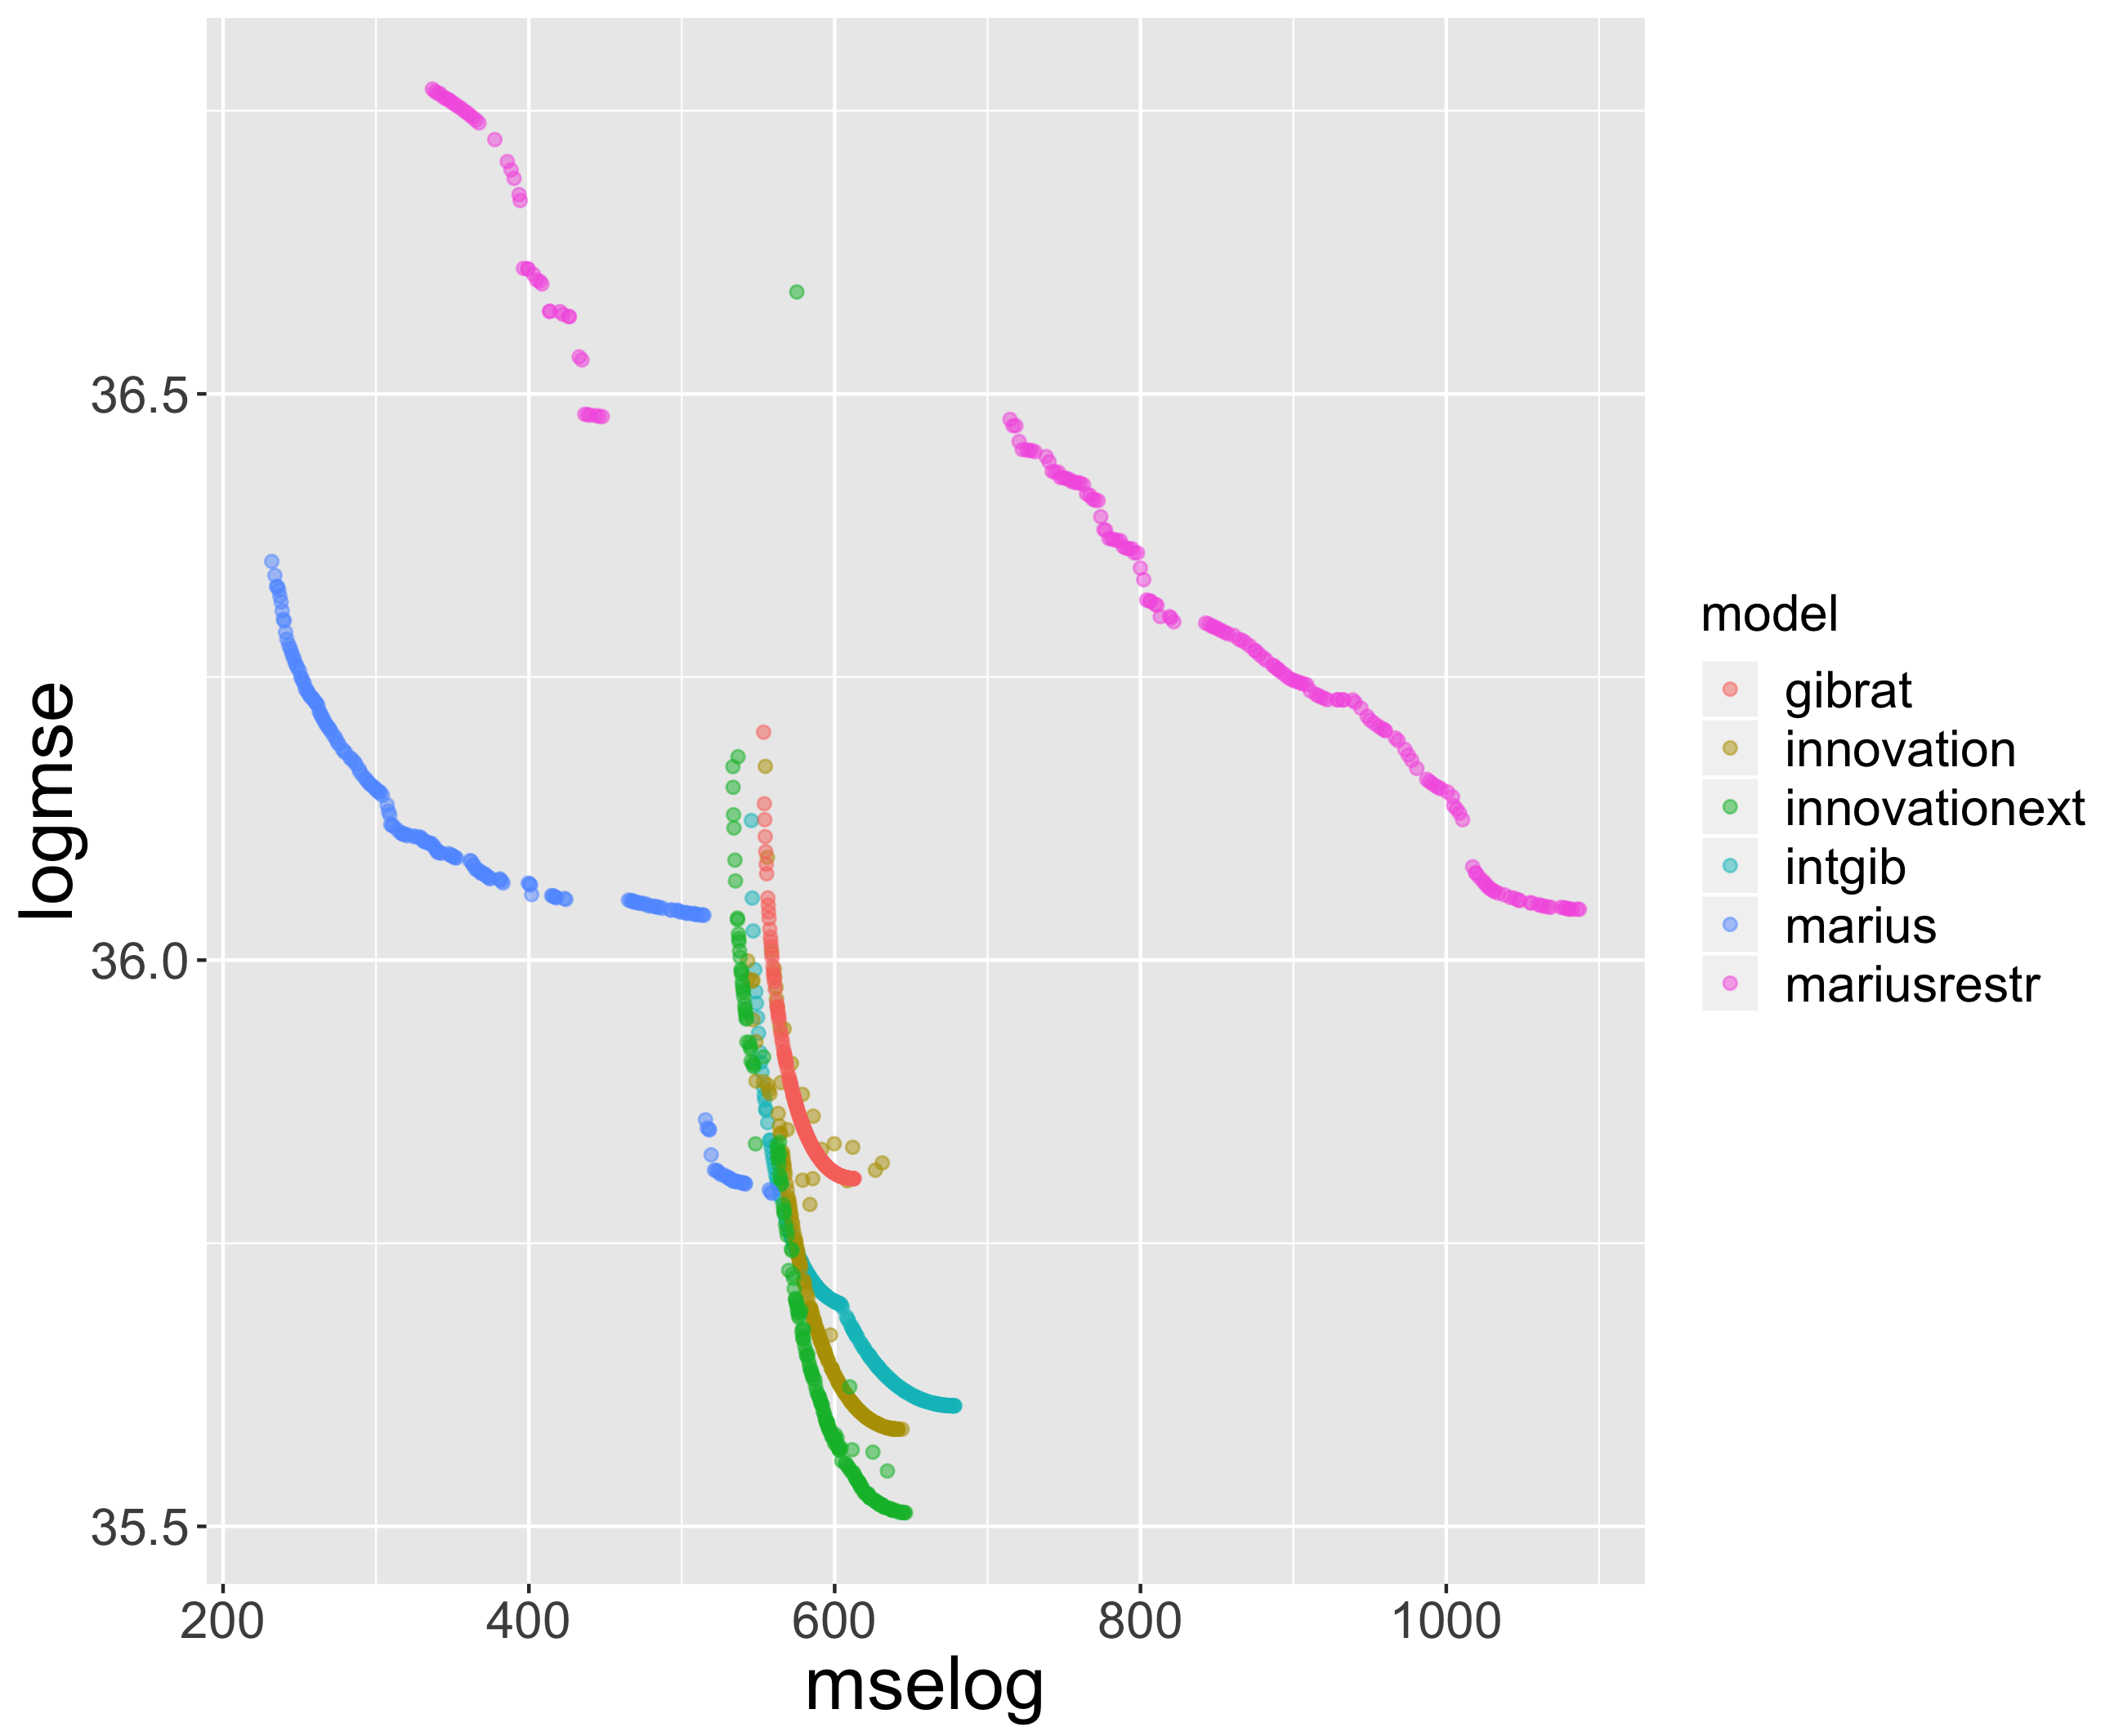
Worldwide calibration of models

Slide 19
Discussion
Synthesis
→ robustness of stylized facts, and of theoretical constructions → complementarity of processes and models
→ importance of the historical/political/geographical context, path-dependency
Open questions
→ linking urban scaling and dynamical models → endogenous consistent urban systems
→ multiscale models
Applications
→ Statistical predictability of city growth and size on short time periods → Largest metropolises are not “monstruopolises”
→ Transfer to practitioners: proactive adaptive strategies are necessary (imitation, or anticipation and risk), emulation (co-opetition)
→ Robustness, variation and sustainability of urban systems (neither norm nor optimum)

Slide 20
Conclusion
→ Robustness of results regarding data sources, multiple models. Need for more systematic model exploration and sensitivity analysis.
→ Model complementarity. Need for more integrated models.
→ Multiple perspectives on urban systems? Need for more interdisciplinarity.
Open repository at https://github.com/JusteRaimbault/UrbanGrowth
Acknowledgments: thanks to the European Grid Infrastructure for access to the infrastructure.

